Slide 1
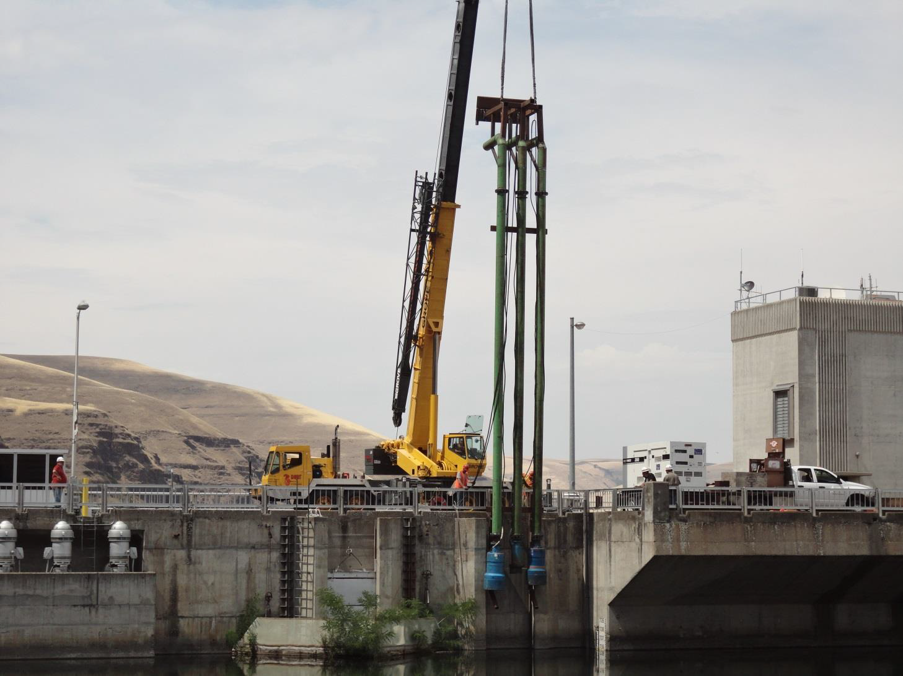

Slide 2
LGR Adult Ladder Temperature Permanent Fix
    NOAA Biological Goals:
    1) Allow fish the opportunity to exit the ladder without stalling or excessive up/down movement.
    2) Give fish a cool transition to the deeper forebay water so they don’t continue to fallback at high rates.
    Discussion: Do not know/have confidence that fallback increases with higher water temperature or certain operational flow pattern and route magnitudes:
    i.e.,
    H0 fish exiting @ higher shallow water = higher fallback (due to greater exposure to surface spill?)
    versus
    H1: fish exiting @ lower deeper water = higher fallback (due to greater exposure to turbine intake flow or deeper spill flow?).
    Corps Biological Goals:
    Reduce ladder entrance/exit differential in temperature to <2 deg F for no delay in fish passage from entrance attraction through ladder exit into deeper water of forebay.

Slide 3
LGR Adult Ladder Temperature Permanent Fix
ESA Consultation:
Covered in 2008 and 2014 FCRPS BiOp but coordination on specific installation details on timing work windows, plus construction effects and component needs/ specifications remain to be closed .
1) Received verbal on fish screens covering end of extended pipes not required due to deep depth (>66’) and limited exposure to entrainment hydraulics for capturing fry or smolts. Need to receive formal confirmation.
2) Scheduled allowable duration and work window dates (currently ending 29 May 2015). Effects::

Slide 4
5/29/2015

Slide 5
LGR Adult Ladder Temperature Permanent Fix
Work window:
Current schedule says install via divers through 29 May 2015. Corps need to know allowable work window end date by 15 September 2014 so BCOE on Final Design can be completed for FY2015 install –or- delayed for FY2016 install.
Normal Operations during construction would be FPP operations for juvenile fish passage and adult fish attraction and passage.
Dive to install each of auxillary pumps entended pipes and Diffuser 14 “chimney” requires the adult ladder exit to be closed in addition to Diffuser 14 Intake OUT = ladder hydraulic function OUT. Best to schedule completion by the first week of May to avoid adult Chinook passage impact.
Full ladder outage required for 3-6 days in May.
30 hr dive for pipe extensions + 35 hr dive for chimney = 65 hrs. If 10 hr dive shifts then single shift days would = 6 days. PREFERRED: If double-shift with 10 hr dive shifts then would = 3 days.
Adult Fish passage distribution: A concern for adult Chinook passage (10 yr 51.8% (42.2-63.5%)): if end 1 May then only 2001 dist’n affected. Minor concern for wild steelhead (10 yr 8.4% (1.8-6.4%)). No concern for sockeye because have not started passage @LGR until mid- to late-June.

Slide 6
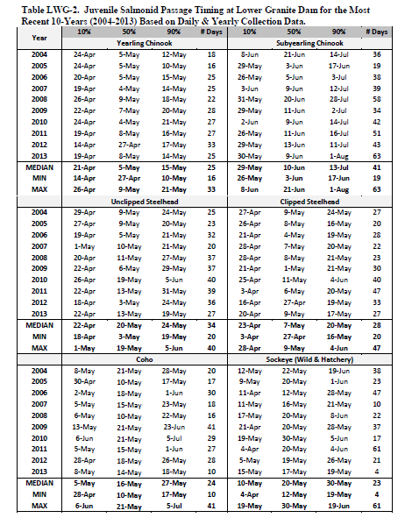
Juvenile Salmon
24 APR – 29 MAY construction could overlap with ~90% run of juvenile yearling Chinook, steelhead, coho, and sockeye passing through summer spill of 20 kcfs @ LGR (16-28% spill for 70-120 kcfs inflow).
Although very high juvenile passage overlap, location of pipe install at LGR ladder should not other than consequential impact juvenile salmonid passage.

Slide 7
Chinook | 2001 | 2005 | 2011 | 2013 | 2013-2004
24APR-29MAY | 117116 | 16264 | 41030 | 26293 | 33620.4
1APR-23APR | 31453 | 11 | 19 | 71 | 173
30MAY-31AUG | 35747 | 16238 | 56153 | 18783 | 31058.6
 | 67200 | 16249 | 56172 | 18854 | 31231.6
Total Run 1APR-31AUG | 184316 | 32513 | 97202 | 45147 | 64852
% 24APR-29MAY | 63.54088 | 50.02307 | 42.21107 | 58.23864 | 51.84173

Slide 8
Wild Steelhead | 2001 | 2005 | 2011 | 2013 | 2013-2004
24APR-29MAY | 394 | 346 | 1496 | 525 | 509.3
1APR-23APR | 2158 | 1032 | 5771 | 2449 | 1485
30MAY-31AUG | 19180 | 5910 | 24551 | 5171 | 4076.5
 | 21338 | 6942 | 30322 | 7620 | 5561.5
Total Run | 21732 | 7288 | 31818 | 8145 | 6070.8
%24APR-29MAY | 1.812995 | 4.74753 | 4.701741 | 6.445672 | 8.3893391

Slide 9
No Sockeye in May

Slide 10
LGR Adult Ladder Temperature Permanent Fix
    Effectiveness Monitoring:
    1) Repeat thermometer coverage to determine temperatures resulting from remedial actions: critical location temperature trending for differential distribution and sub-lethal maximums or too cold zoning.
    2) PIT passage evaluation real-time to determine delay behaviors, fallout, up/down, over-nighting, multiple re-ascension, etc.
    3) Hour and daily observe numbers and density of adults holding and exiting patterns (time and timing) through ladder exit to ensure successful exit and movement upriver through immediate forebay zone. Possible methodology: split-beam (or split-beam tracking) hydro-acoustics covering ladder exit numbers and direction to priority spill and priority turbines (determine risk to fallback and dominant route of fallback).
      A) Hydro-acoustics for sockeye/chinook behavior confounded by shad. Could tag only shad with JSATs or RT to sort?
      B) RT possible, better behavior tracking/directionality from JSATs sample of sockeye/summer chinook ~50 minimum, 100 better depending on trap location.
        i) During future LGR PSE following completion new JFF1a and 1b. Likely 2017?
        ii) If region deems priority importance…then Prior future LGR PSE. Likely 2016? Concern is what other construction being performed simultaneously where other construction consequences/effects could confound ladder temperature results interpretation. Likely most significant is major JFF1a construction 2015-2017.

